Slide 1
Consumer (Segment) Analysis - Typical problems - Illustration of a segmentation process

Slide 2



The following slides illustrates some typical problems in segmentation

Slide 3
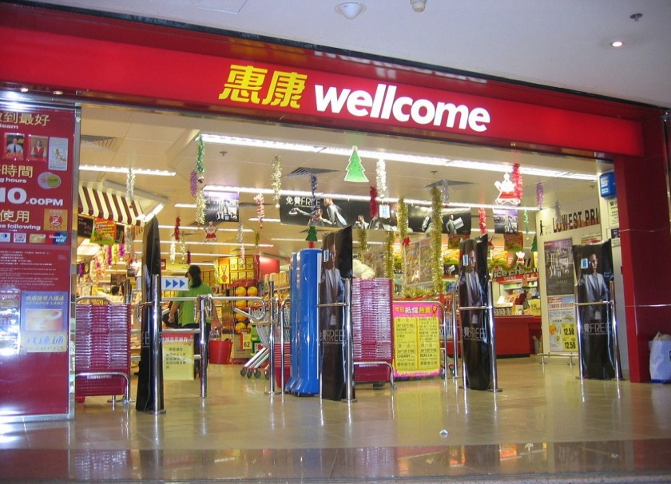

Customer Analysis for “Wellcome’s segmented pricing strategies”
Local market
Mass market
Resident
Price sensitive people
Elderly
Family (Housewife)
Notes:
P

Slide 4

80 Pickup Locations
100,000 users
Plum
Hong Kong
500 + Restaurants
Meal Delivery Apps. “Food” and “Tech” Company
Delivery lunch to 15 Districts, 80 pickup points in HK
Dedicated food curator team handpicks dishes and brings to pickup locations near to customers
Founded in Nov 2017. Originating in HK, and also serves Singapore and New York City

Slide 5
Plum
Hong Kong
Marketing Segmentation
Geographic
Demographic
Psychographic
Behavioural
Business District
Industrial Areas
Hospitals
Professionals
Working Class
25-40 years old
Smartphone users
Strivers
Value Oriented
Lower sociability
Quality
Convenience
Time Constrained
What are the problems here?
Strategies:
Operating Monday to Friday (except public holidays)
Selection of 6-7 meals, 2 Beverages, 2-3 desserts or side dishes a day
4 different types of cuisine : Chinese, Western, Vegetarian & Asian
Menu Price $39-79

Slide 6
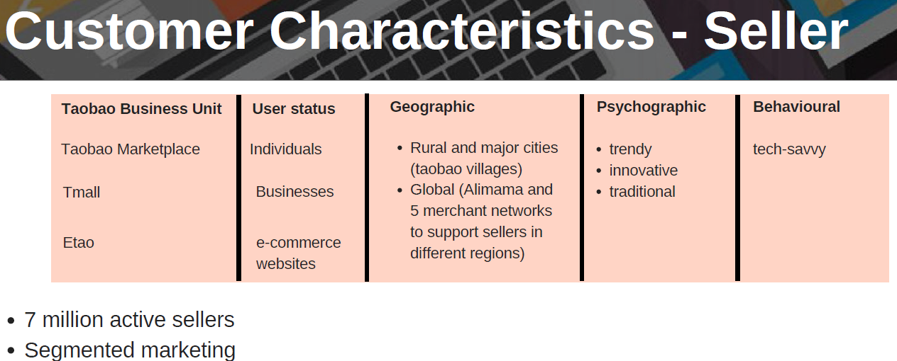
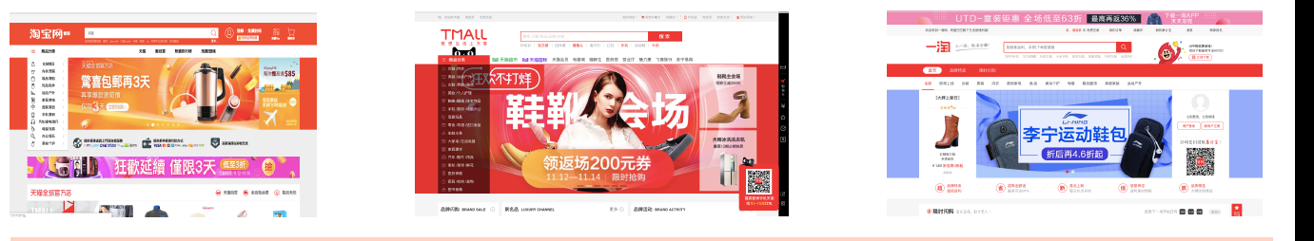
What are the problems here?

Slide 7

Segmentation for Classic Coke
Demographic segmentation (age) is adopted
Children (1-10 years old) | Teenagers (10-24 years old) | Adults (25-54 years old) | Elderly (55 + ys old)
Like soft drinks Drinks choices limited by parents Influenced by the packages | High ability of acceptance Explore new things Addicted to the Internet | Respect and like Chinese cultures Healthy lifestyle | “Old things are good; New things are bad” Healthy lifestyle
What are the problems here?

Slide 8
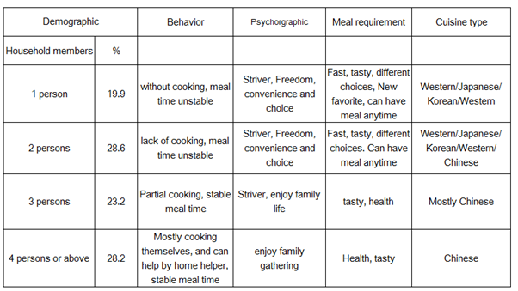


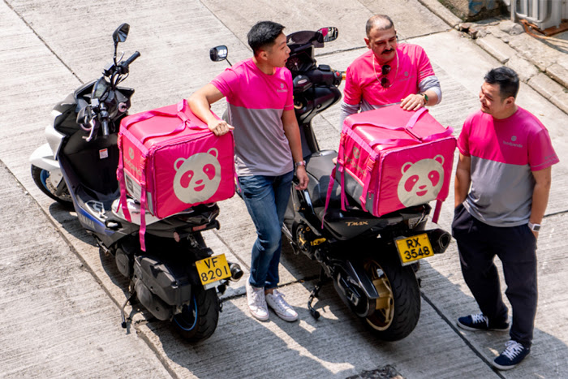
Conceptually, segmentation based on household size is OK. However, it does not seem to be very useful for foodpanda. How can household size matter? How can foodpanda differentiate these four groups of consumers in its marketing activities? While I can see household size may matter if you are considering a loyalty/quantity discount program, segmenting market based on it does not need to be in such a detail.
The table suggests household size the most important basis. But for operational and competitive/branding reasons, behavior factors (such as when and where the orders, cuisine types and requirements) may be more important for foodpanda to coordinate restaurants and delivery, and to build foodpanda's competitive advantages.
In general, demographic factors are easier to use for segmentation, but behavioral factors are increasingly used in practice: although more difficult, it is often a lot more effective.

Slide 9
Segmentation for A Travel Agency
An Illustration of a segmentation process

Slide 10
Suppose you are planning to open a travel agency in Kowloon area, with big universities nearby…
Define your market
Define the segmentation variables
Segment the market
Describe the segments
Select the target segment(s)
Targeting

Slide 11
Step 1: Define your market
Who are prospective/potential customers?
Who are the travelers?
Who probably buy the tickets?
Who influence the travelers’ decisions?
Why probably make the purchase?
A tentative list of potential customers
Travelers for leisure
Business travelers
University staff
Travel organizers within organizations

Slide 12
Step 2: Identifying segmentation bases & prioritize
What are the segmentation variables?
Characteristics
Behavior
Attitude
Restrictions
A tentative list of variables
Purpose of traveling: business, leisure
Wants: comfort, excitement, convenience…
Age, income and price sensitivity
Travel by airplane or by car
Time schedule

Slide 13
Step 3: segment the market in a table format
3 segmentation bases/dimensions
Segmt. | purpose |  | wants |  |  | income
 | business | leisure | comfort | excitement | convenience | high | medium | low
1
2
3
4
5
…

Slide 14
Step 3: segment the market
Segmt. | purpose |  | wants |  |  | income
 | business | leisure | comfort | excitement | convenience | high | medium | low
working | √ |  |  |  | √ | √ | √
being at home |  | √ | √ |  |  | √ | √
venturing |  | √ |  | √ |  | √
You pick a name for each of the segments

Slide 15
Step 4: describe the segments in more details
We need to know
Demographics and sizes of the segments
Idiosyncrasies/interests/values/attitudes
(travel frequencies, how long, preferences)
How to reach them respectively

Slide 16
Step 5: select the target segments
The factors to evaluate the targets
Size of the segment
Short/long run prospect
Potential impact on the market
Our competency
Targeting capability
Competition, etc.

Slide 17
Step 5: select the targets
Factors | Weights | Segment 1 |  | Segment 2 |  | Segment 3
 |  | score | w * s | score | w * s | score | w * s
Size………
Short term potential
Long term potential
……………
Priority score
You pick these factors

Slide 18
Step 5: select the targets
Factors | Weights | Segment 1 |  | Segment 2 |  | Segment 3
 |  | score | w * s | score | w * s | score | w * s
Size……… | 3 | 1 | 3 | 4 | 12 | 4 | 12
Short term potential | 2 | 2 | 4 | 4 | 8 | 3 | 6
Long term potential | 3 | 5 | 15 | 5 | 15 | 4 | 12
…………… | ..
Priority score |  |  | 45 |  | 60 |  | 67

